Slide 1
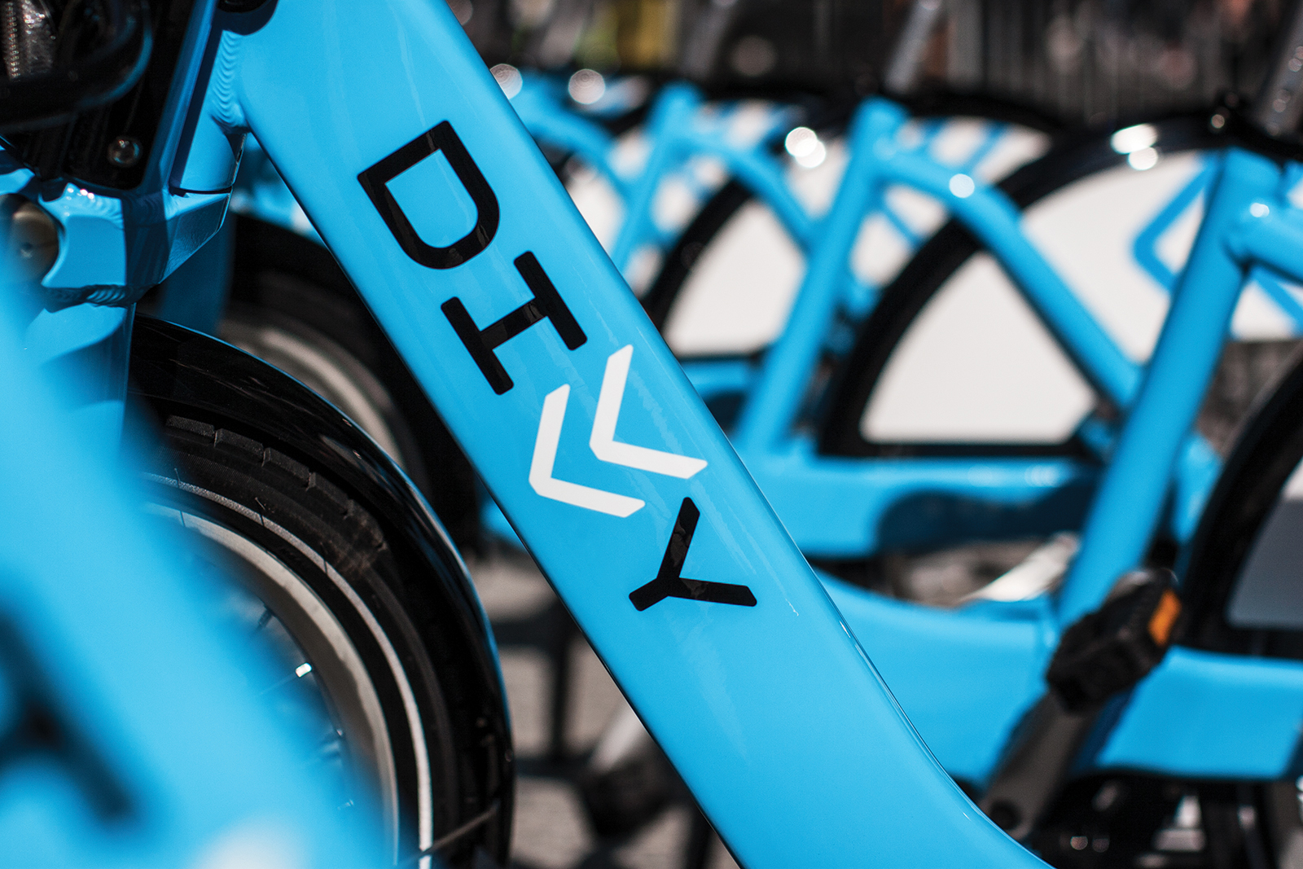

Slide 2
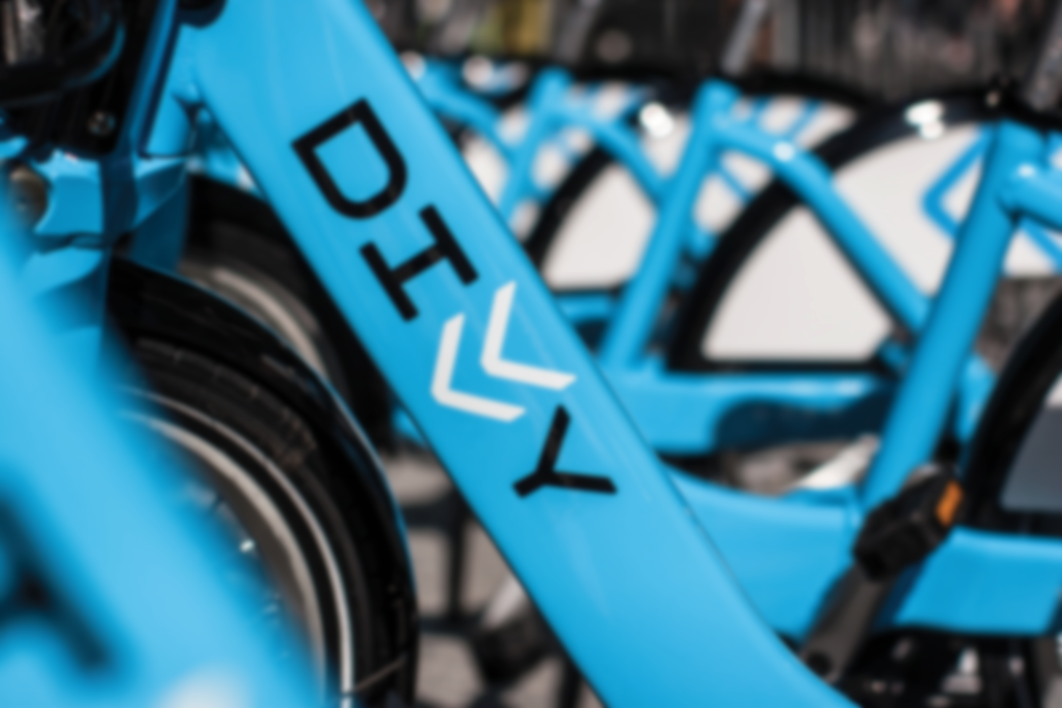
DEMAND PREDICTION OF DIVVY BIKES
Akshay Sheokand
Jaynil Sonavane
Naga Bhaskar Muddana

Slide 3
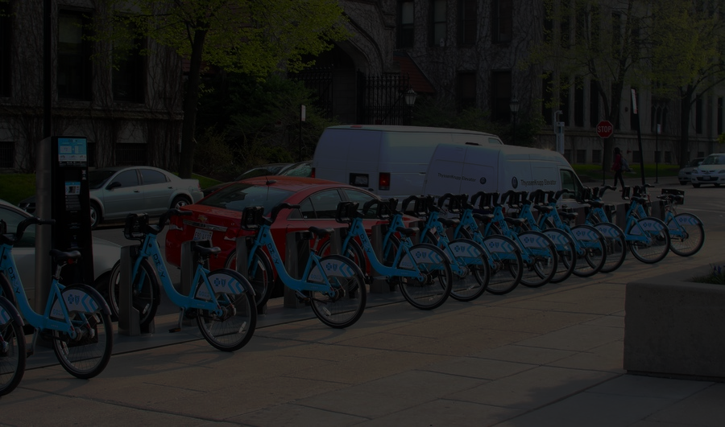
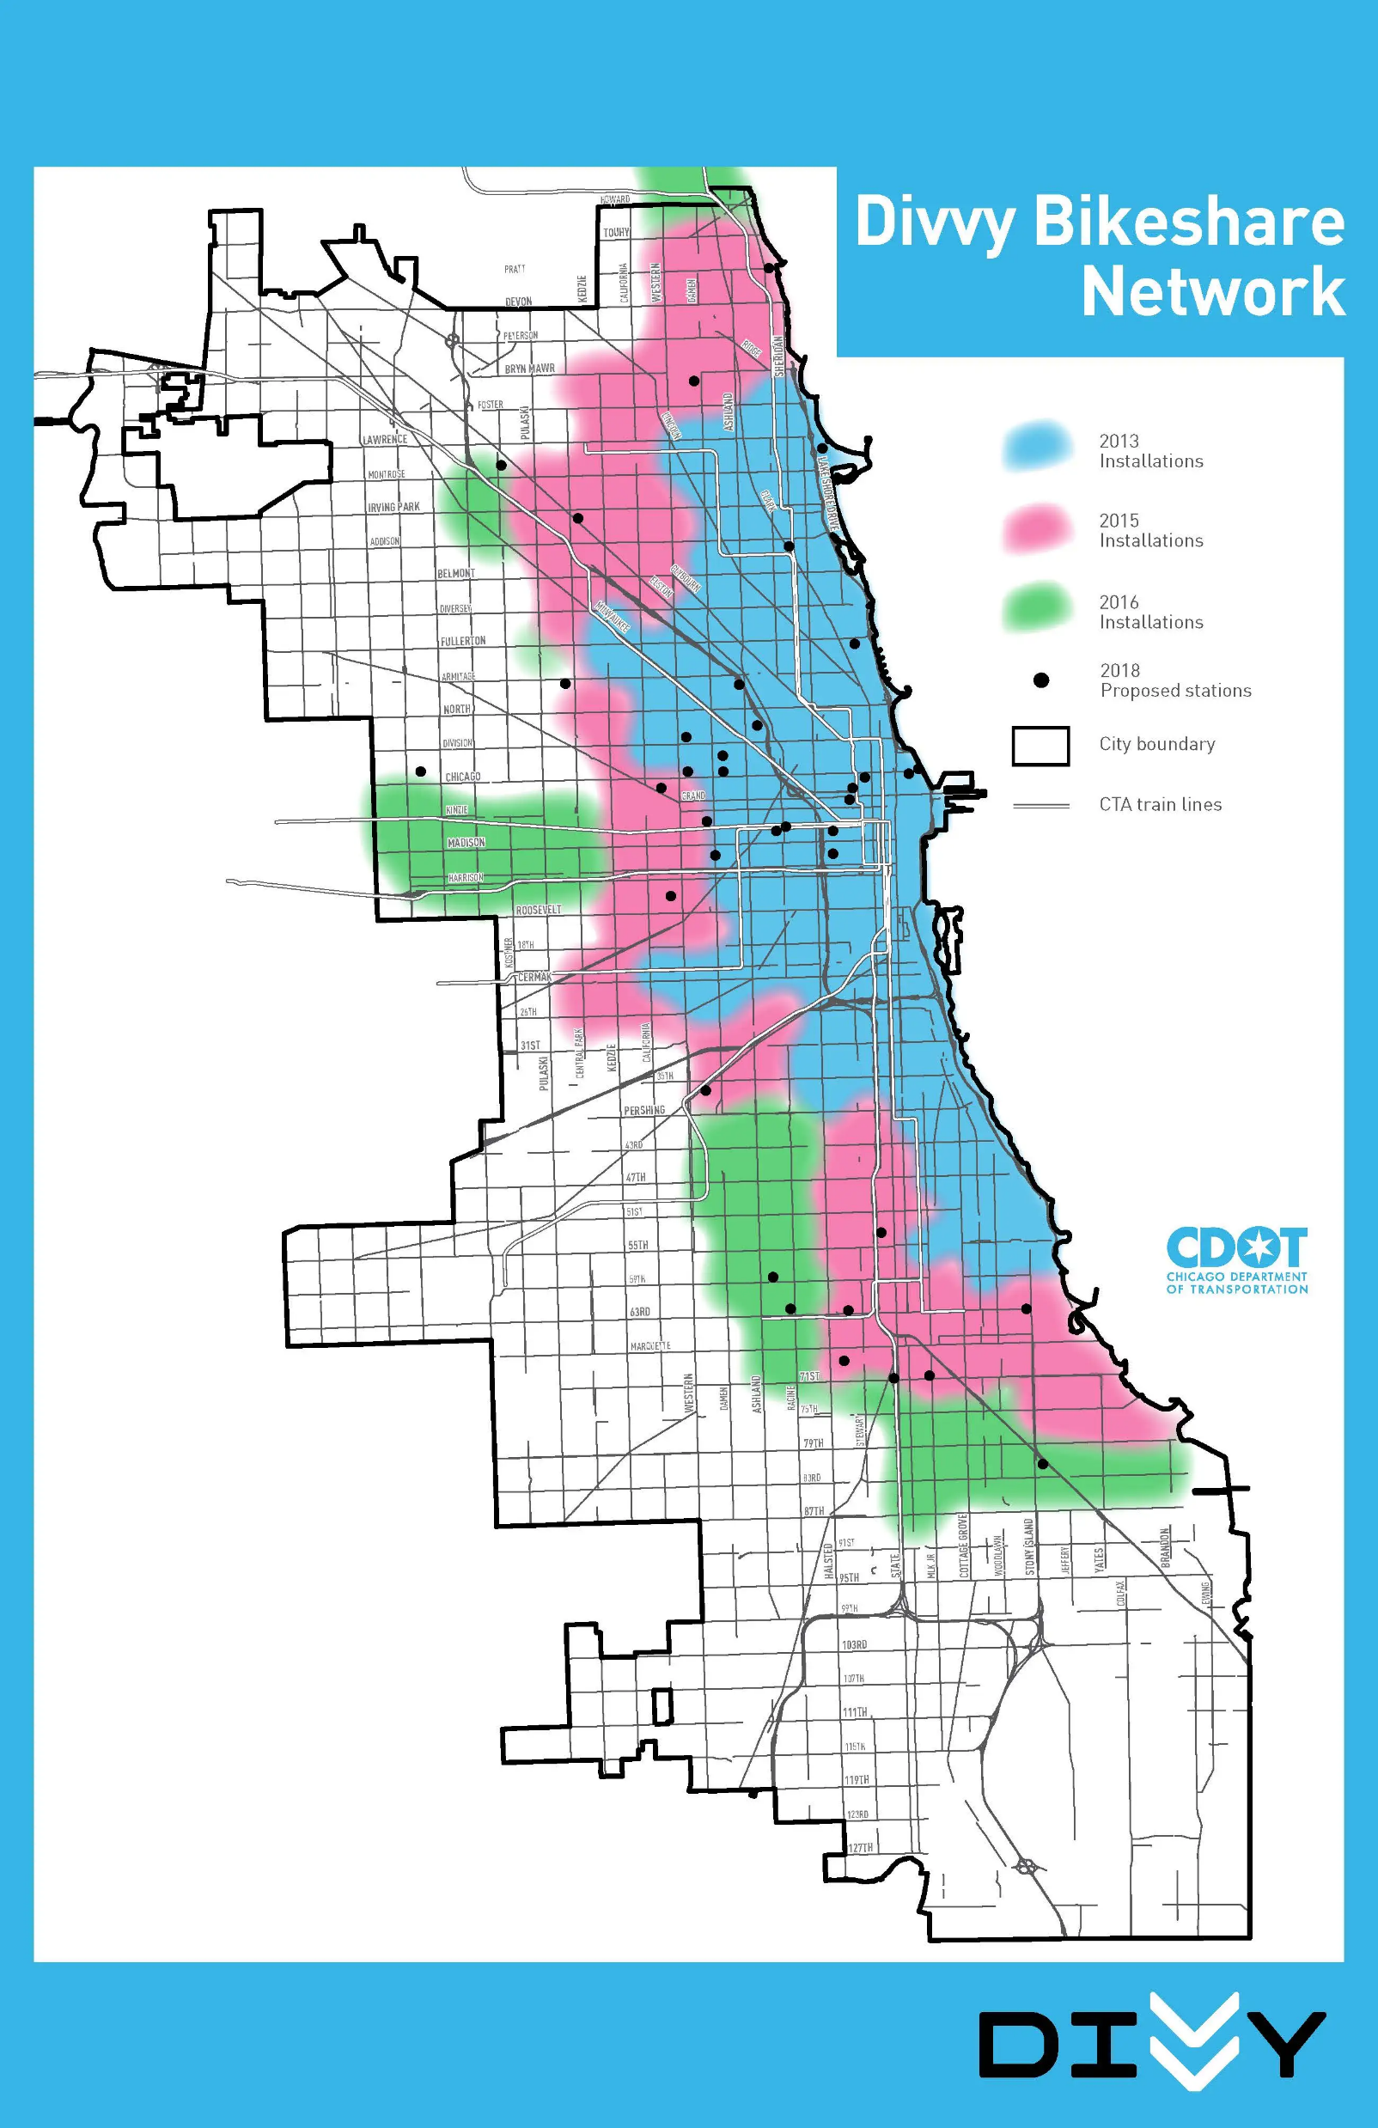
Introduction:
Divvy is a bicycle sharing system in the City of Chicago and two adjacent suburbs operated by Motivate for the Chicago Department of Transportation.
It operates 5800 bicycles at 580 stations in an area bounded by 87th Street on the south, Central Street in Evanston on the north, Rainbow Beach Park near South Shore Drive on the east, and Harlem Avenue in Oak Park on the west .
Divvy is available for use 24 hours/day, 7 days/week, 365 days/year, and riders have access to all bikes and stations across the system.
Since, the data is related to people’s daily life, exploring it can help us find some interesting phenomena.
A fun and affordable way to get around town
-DIVVY

Slide 4
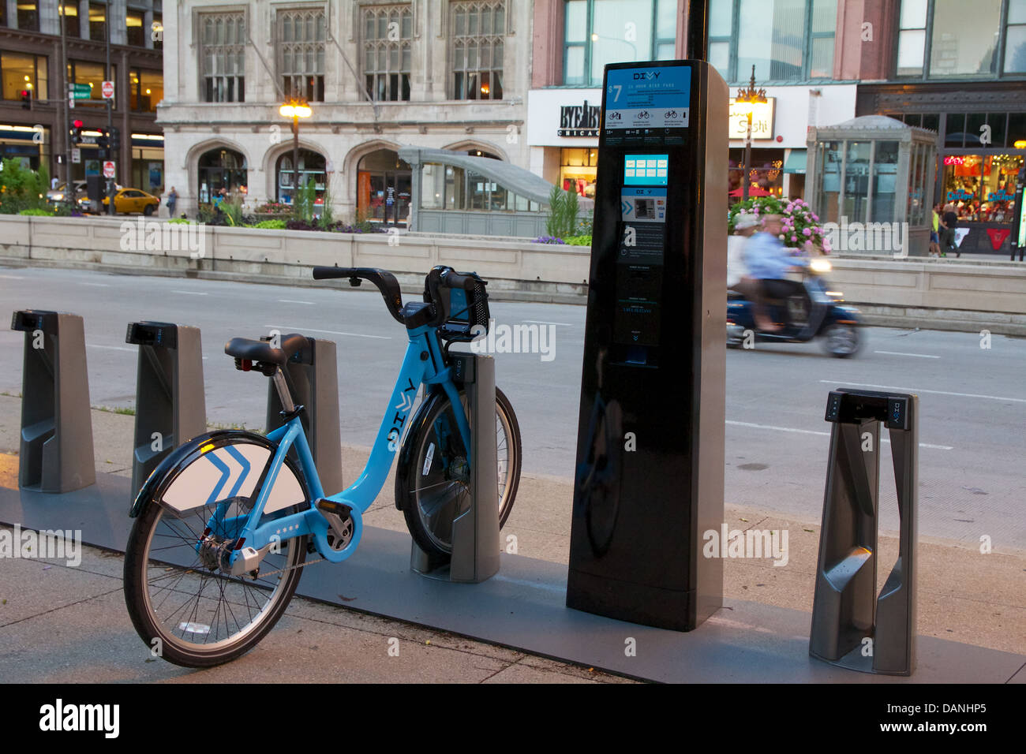
Problem Setting
I wanted to use divvy to commute home around rush hour. I check the station almost every day. The stations are always empty. I get a bike at most 1/4 times – A Frustrated Customer
This must have faced by some of us during the busy hours.
The goal is to predict the demand of the bikes .
To determine the busiest stations.
Provide recommendations

Slide 5
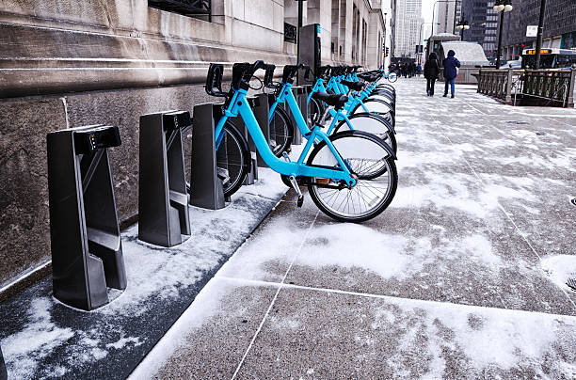
Techniques: Technologies:
EDA
Feature Engineering
Modelling
PySpark
GCP
Jupiter Notebook

Slide 6
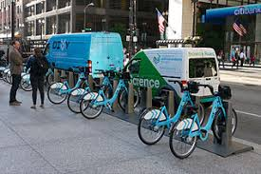
Data Collection
DIVVY hosts its data for the public in the below link
(https://divvy-tripdata.s3.amazonaws.com/index.html)
We have created buckets in GCP and pushed all the data.
Data hosted by DIVVY is per month in a year.
Multiple datasets are created to perform different tasks(Analyze, visualize and modelling)

Slide 7
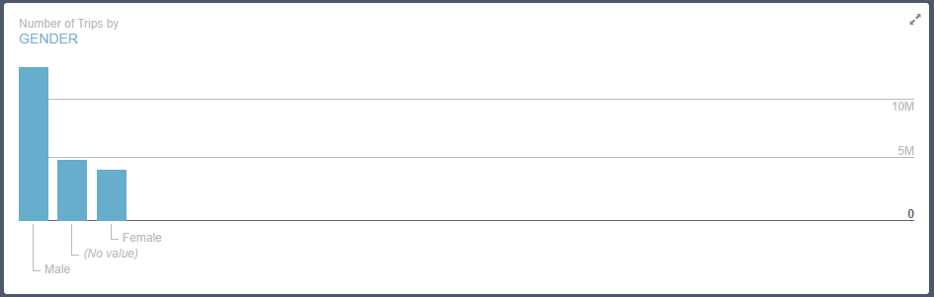
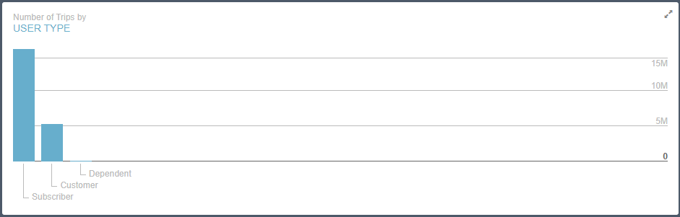
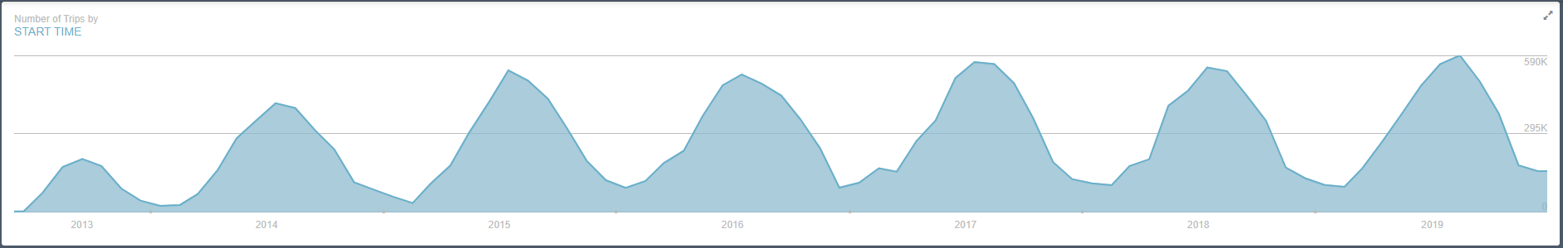
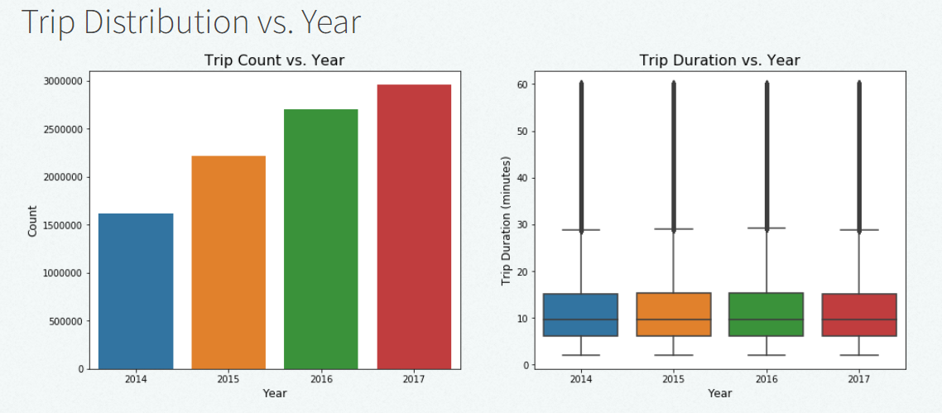
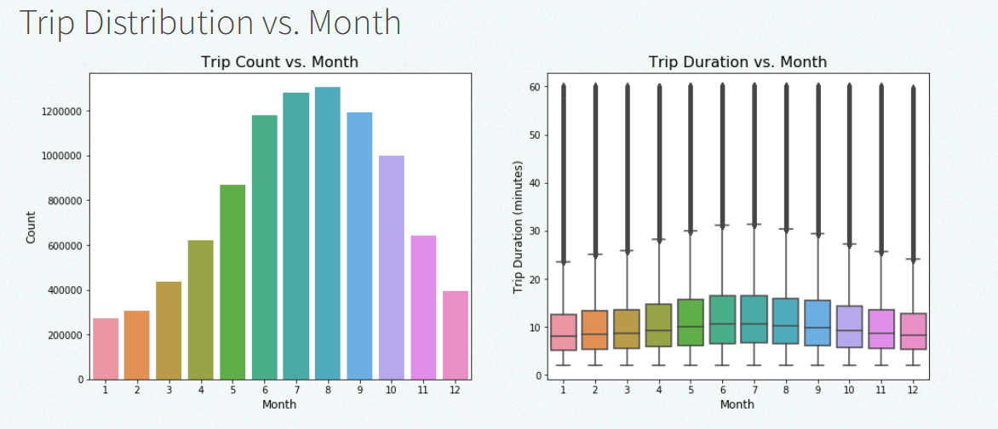
Visualization

Slide 8
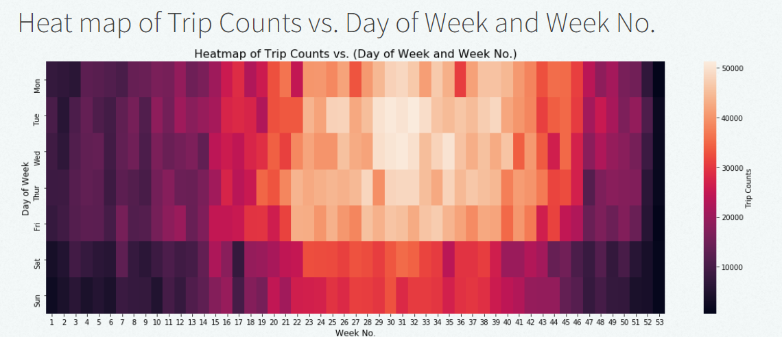
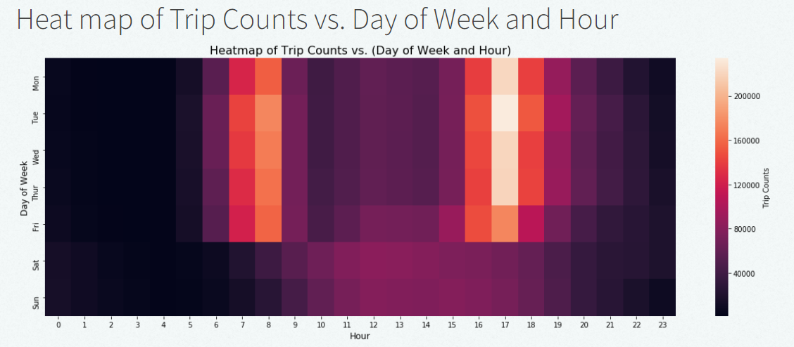

Slide 9
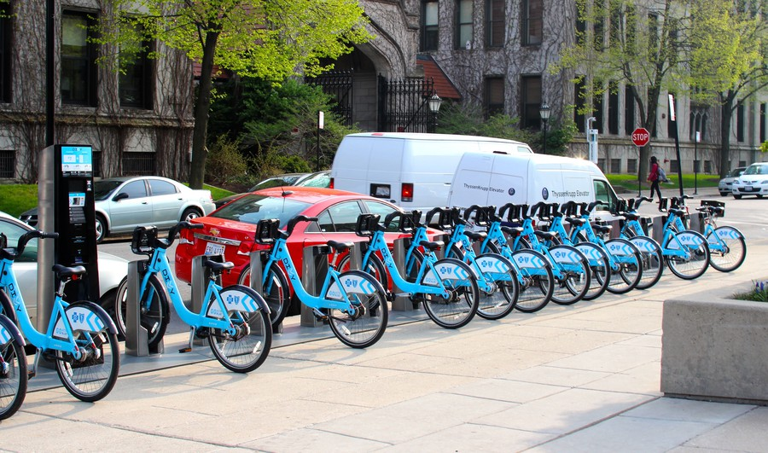
Results:
Model | Mean Squared Error | Mean Absolute Error
Linear Regression | 3.26 | 1.08
Decision Tree (depth = 8) | 2.79 | 1.05
Random Forest Regression (depth = 8) | 2.59 | 1.03
Gradient Boosting Regressor (depth = 4) | 3.77 | 0.93

Slide 10
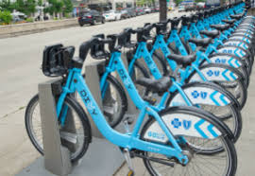
Now the stands are plenty with bikes to serve the customers - THE END

